Slide 1

Linear Programming-Sensitivity Analysis
SCHOOL OF DATA SCIENCE AND FORECASTING
DEVI AHILYA VISHWAVIDYALAYA, INDORE

Slide 2
Sensitivity Analysis
Sensitivity analysis (or Post-optimality analysis) adds dynamic dimension in LP optimum solution for investigating the impact of changes in the model parameters (e.g. coefficients of objective and constraints) and right-hand side values of the constraints.
Sensitivity analysis provides sensitivity of the optimal solution to the changes made in the model. It can be used to answer some “what –if” type questions about the problem.
Sensitivity analysis is important for management for taking decisions in the dynamic environment with –
1. Changes in the coefficients of objective function (per unit price or cost)
2. Changes in the coefficients of constraints (per unit usage of the resources)
3. Changes in the availability of the resources.

Slide 3
Graphical Sensitivity Analysis
The following cases of the sensitivity analysis will be discussed based on the graphical solution:
Changes in the coefficients of objective function (ranges of optimality)
Changes in the right-hand side of the constraints (ranges of feasibility)
Unit worth of the resources (dual prices)

Slide 4
Changes in the coefficients of objective function
The general objective function in two variables for a LPP can be written as Max. or Min. z = c₁x₁ + c₂x₂
Changes in the coefficients c₁ and c₂ will change the slope of the z-line and finally may change the optimal corner point.
However, there is a range of variation for both c₁ and c₂ that will keep the current optimum point unchanged.
Our interest is to determine the range of optimality for the ratio c₁/c₂ or c₂/c₁ that will keep the current optimum solution unchanged.
It gives a flexibility to the managers to change the price (or cost) per unit up to a certain range without affecting optimality.

Slide 5
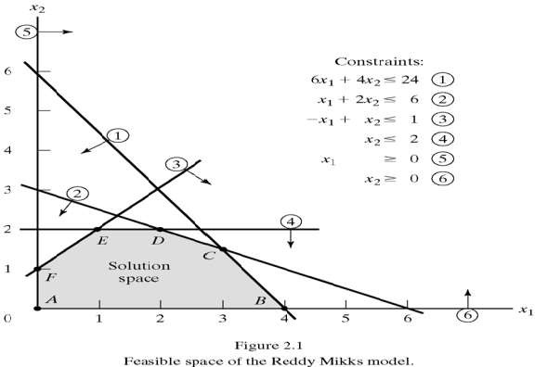
Changes in the coefficients of objective function-Example
Objective Function:
Maximize Z= 5X₁ + 4X₂
Constraints:
Raw Material M1:
6X₁ + 4X₂ ≤ 24 ….…...(1)
Raw Material M2:
X₁ + 2X₂ ≤ 6…….…....(2)
Market Demand:
-X₁ + X₂ ≤ 1 ……….…(3)
Market Demand:
X₂ ≤ 2 ………….…….(4)
Non-Negativity Conditions:
X_{1,} X₂ ≥ 0 …………… (5, 6)
Optimum Point is C where Z = 21, X₁ = 3, X₂ = 1.5

Slide 6
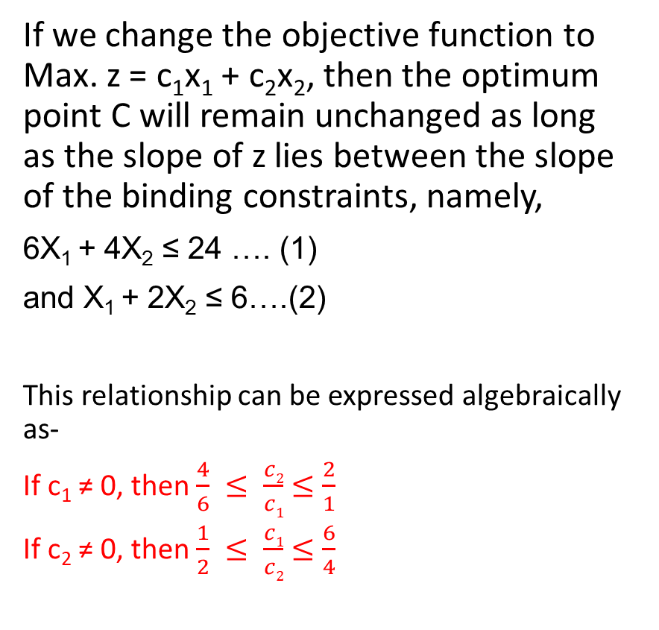
Changes in the coefficients of objective function-Example
If we change the objective function to Max. z = c₁x₁ + c₂x₂, then the optimum point C will remain unchanged as long as the slope of z lies between the slope of the binding constraints, namely,
6X₁ + 4X₂ ≤ 24 …. (1)
and X₁ + 2X₂ ≤ 6….(2)
This relationship can be expressed algebraically as-
If c₁ ≠ 0, then $\frac{4}{6} ≤ \frac{c2}{c1}$ $≤\frac{2}{1}$
If c₂ ≠ 0, then $\frac{1}{2} ≤ \frac{c1}{c2}$ $≤\frac{6}{4}$
Optimum Point is C where Z = 21, X₁ = 3, X₂ = 1.5

Slide 7
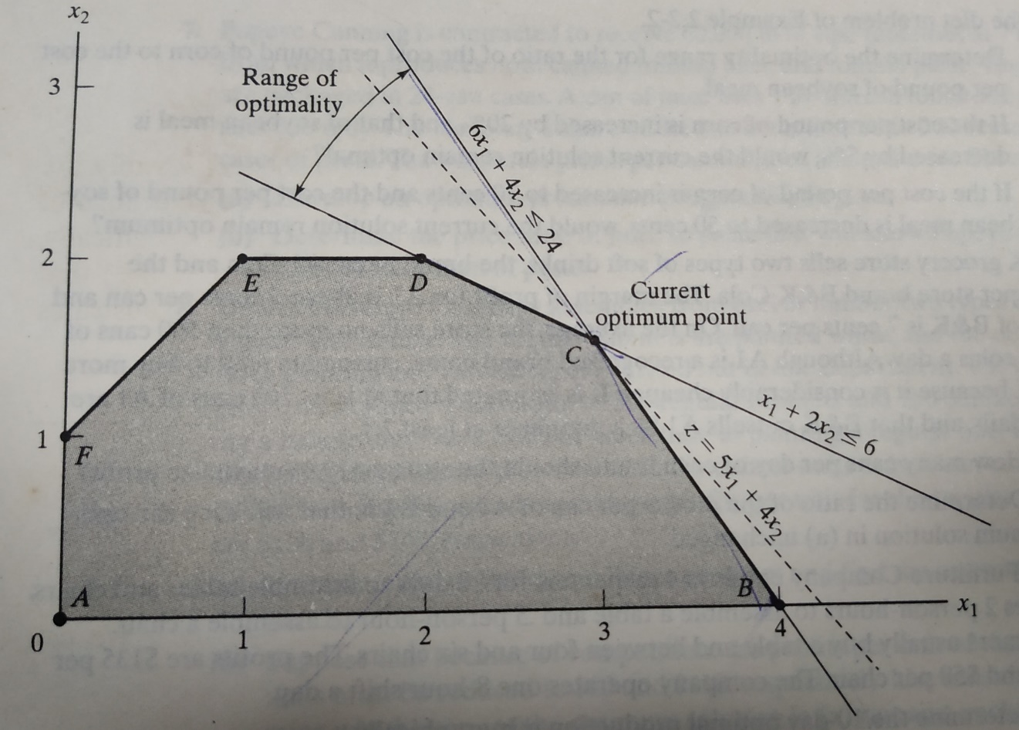
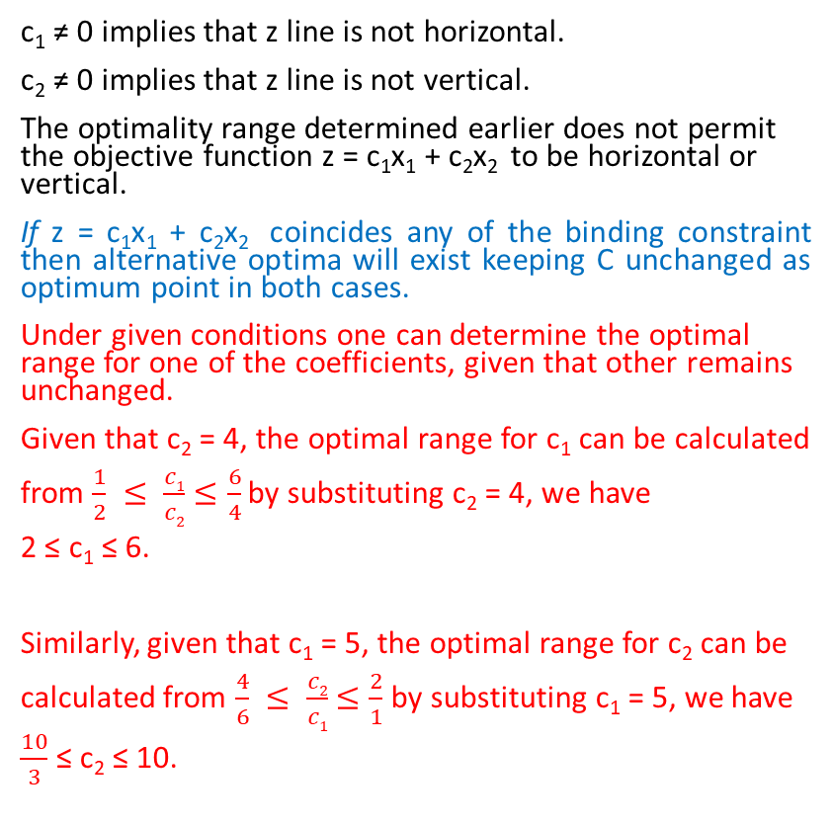
Changes in the coefficients of objective function-Example
c₁ ≠ 0 implies that z line is not horizontal.
c₂ ≠ 0 implies that z line is not vertical.
The optimality range determined earlier does not permit the objective function z = c₁x₁ + c₂x₂ to be horizontal or vertical.
If z = c₁x₁ + c₂x₂ coincides any of the binding constraint then alternative optima will exist keeping C unchanged as optimum point in both cases.
Under given conditions one can determine the optimal range for one of the coefficients, given that other remains unchanged.
Given that c₂ = 4, the optimal range for c₁ can be calculated
from $\frac{1}{2} ≤ \frac{c1}{c2}$ $≤\frac{6}{4}$ by substituting c₂ = 4, we have
2 ≤ c₁ ≤ 6.
Similarly, given that c₁ = 5, the optimal range for c₂ can be
calculated from $\frac{4}{6} ≤ \frac{c2}{c1}$ $≤\frac{2}{1}$ by substituting c₁ = 5, we have
$\frac{10}{3}$ ≤ c₂ ≤ 10.
Optimum Point is C where Z = 21, X₁ = 3, X₂ = 1.5

Slide 8
Changes in the availability of the resources
In LP models, constraints, directly or indirectly, represent the usage of limited resources.
The values given at right-hand side represent limits on the availability of the resources.
A change in the right-hand side for a constraint may affect the feasible region and perhaps cause a change in the optimum solution to the problem.
The range of feasibility is determined by finding the right-hand side values such that the same two binding constraints remains binding.
The change in the right-hand side will create a parallel line only. Therefore, optimum solution point will slide along the line.

Slide 9
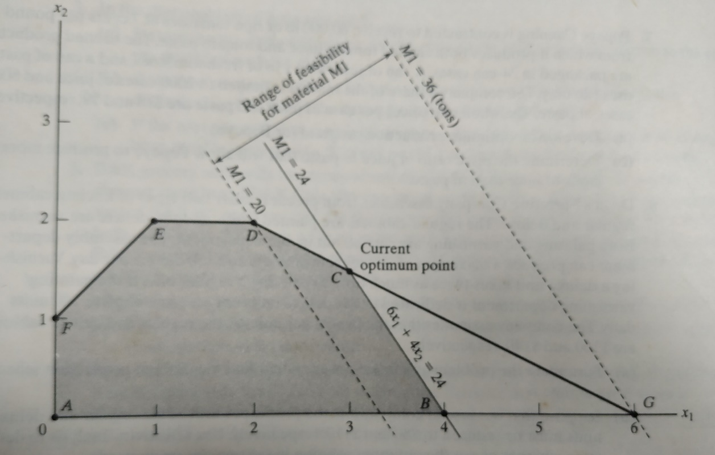
Changes in the availability of the resources-Example
Objective Function:
Maximize Z= 5X₁ + 4X₂
Constraints:
Raw Material M1:
6X₁ + 4X₂ ≤ 24 ….…...(1)
Raw Material M2:
X₁ + 2X₂ ≤ 6…….…....(2)
Market Demand:
-X₁ + X₂ ≤ 1 ……….…(3)
Market Demand:
X₂ ≤ 2 ………….…….(4)
Non-Negativity Conditions:
X_{1,} X₂ ≥ 0 …………… (5, 6)
As availability of raw material M1 changes, keeping the availability of other binding resource M2 as such, the optimum solution at point C will slide along the line segment DG. Any change in M1 outside the range of this segment will render point C infeasible.

Slide 10
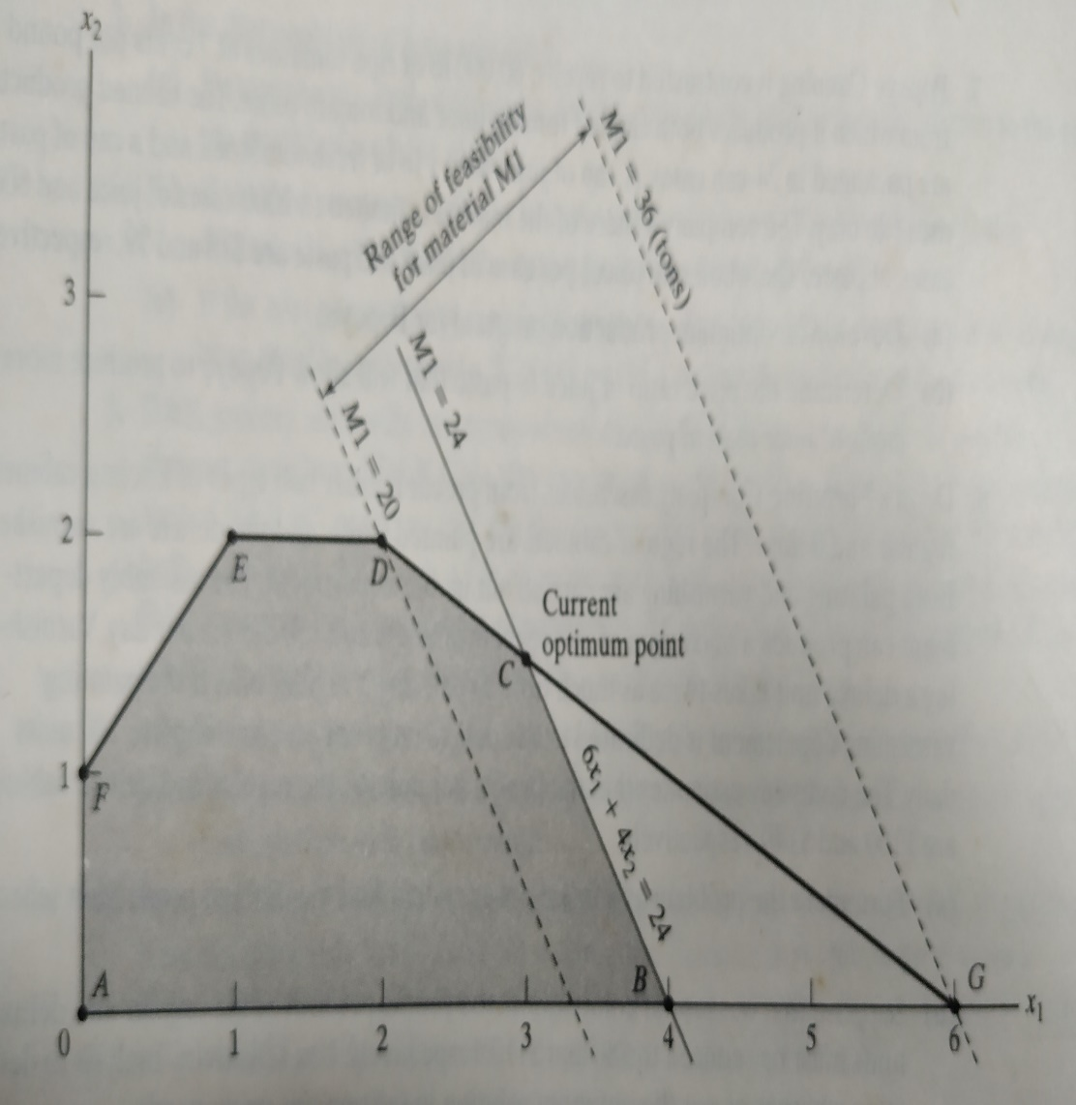
Changes in the availability of the resources-Example
As availability of raw material M1 changes, keeping the availability of other binding resource M2 as such (i.e. 6), the optimum solution at point C will slide along the line segment DG. Any change in M1 outside the range of this segment will render point C infeasible. Therefore, end points D (2,2) and G (6,0) delineate the feasibility range for M1.
Amount for M1 at D = 6X₁+4X₂=6x2+4x2=20 tons
Amount for M1 at G = 6X₁+4X₂=6x6+4x0=36 tons
Given M2 = 6,
the feasibility range for M1 is 20 ≤ M1 ≤ 36

Slide 11
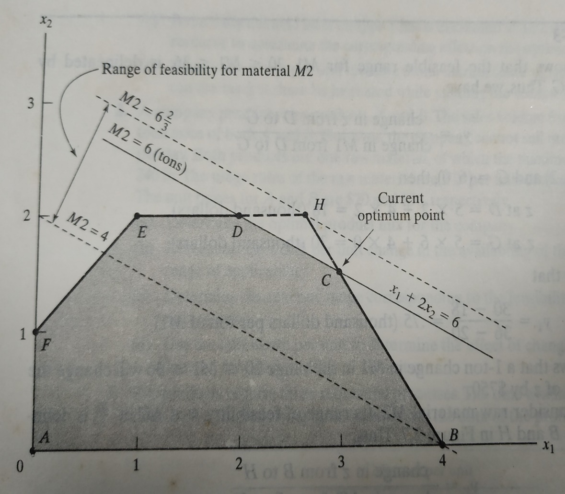
Changes in the availability of the resources-Example
Now consider raw material M2. As availability of raw material M2 changes, keeping the availability of other binding resource M1 as such (i.e. 24), the optimum solution at point C will slide along the line segment HB. Any change in M2 outside the range of this segment will render point C infeasible. Therefore, end points B(4,0) and H(8/3,2) delineate the feasibility range for M2.
Amount for M2 at B = X₁+2X₂=4+2x0=4 tons
Amount for M2 at H = X₁+2X₂= 8/3 + 2x2=20/3 tons
Given M1 = 24,
the feasibility range for M2 is 4 ≤ M2 ≤ 20/3

Slide 12
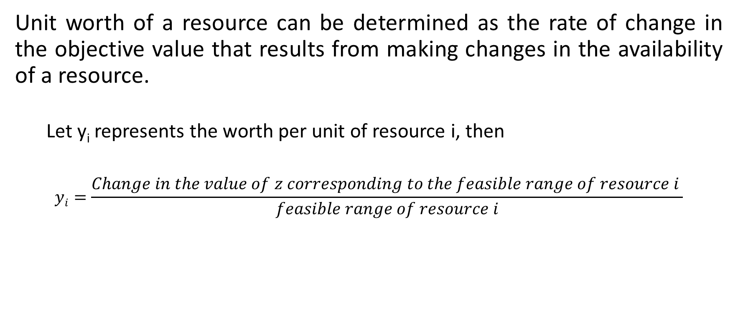
Unit Worth of a Resource (Dual Price)
Unit worth of a resource can be determined as the rate of change in the objective value that results from making changes in the availability of a resource.
Let y_{i} represents the worth per unit of resource i, then
$$yi=\frac{Change in the value of z corresponding to the feasible range of resource i }{feasible range of resource i}$$

Slide 13
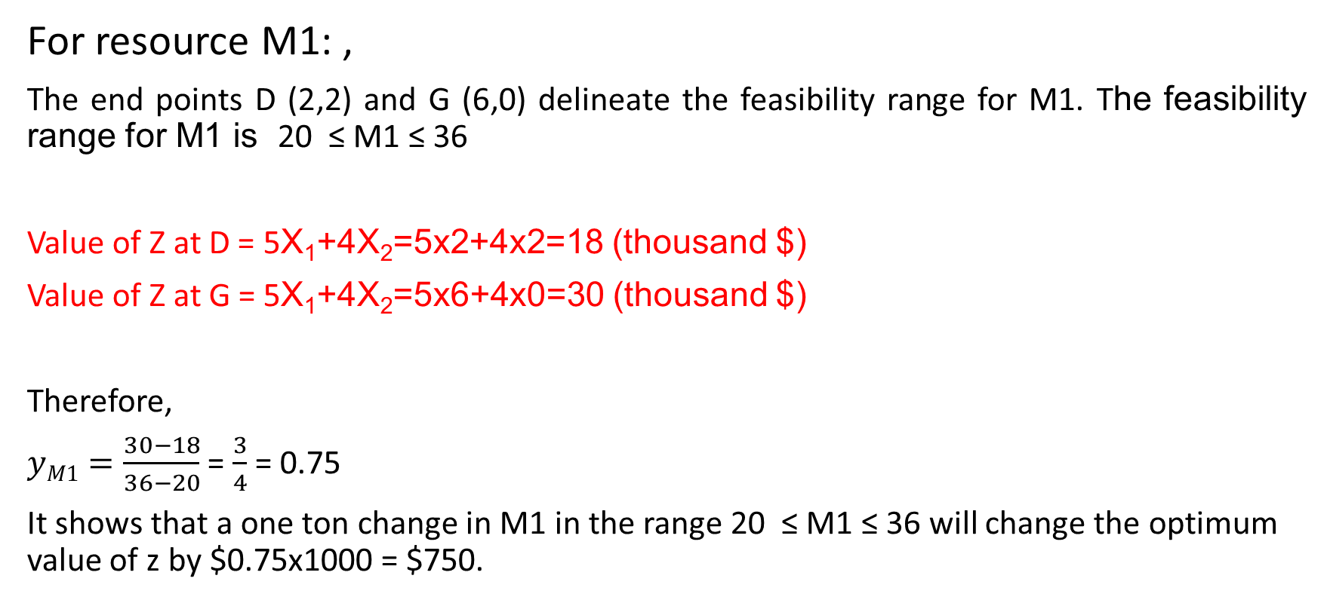
Unit Worth of a Resource (Dual Price)
For resource M1: ,
The end points D (2,2) and G (6,0) delineate the feasibility range for M1. The feasibility range for M1 is 20 ≤ M1 ≤ 36
Value of Z at D = 5X₁+4X₂=5x2+4x2=18 (thousand $)
Value of Z at G = 5X₁+4X₂=5x6+4x0=30 (thousand $)
Therefore,
$yM1=\frac{30−18}{36−20}$ = $\frac{3}{4}$ = 0.75
It shows that a one ton change in M1 in the range 20 ≤ M1 ≤ 36 will change the optimum value of z by $0.75x1000 = $750.

Slide 14
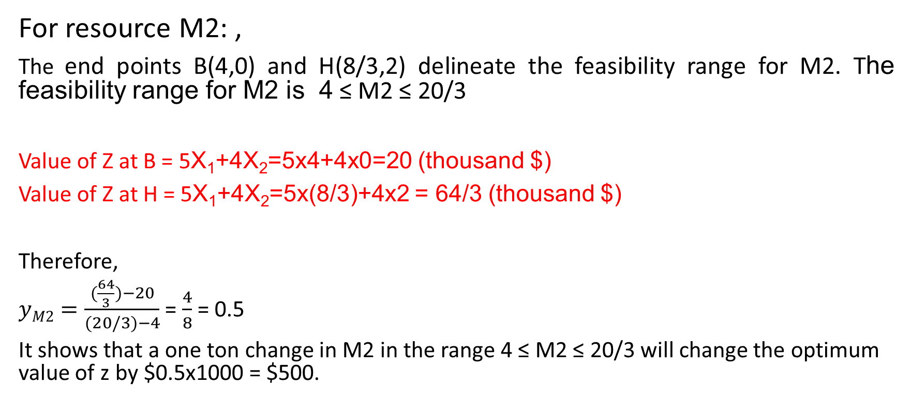
Unit Worth of a Resource (Dual Price)
For resource M2: ,
The end points B(4,0) and H(8/3,2) delineate the feasibility range for M2. The feasibility range for M2 is 4 ≤ M2 ≤ 20/3
Value of Z at B = 5X₁+4X₂=5x4+4x0=20 (thousand $)
Value of Z at H = 5X₁+4X₂=5x(8/3)+4x2 = 64/3 (thousand $)
Therefore,
$yM2=\frac{(\frac{64}{3})−20}{(20/3)−4}$ = $\frac{4}{8}$ = 0.5
It shows that a one ton change in M2 in the range 4 ≤ M2 ≤ 20/3 will change the optimum value of z by $0.5x1000 = $500.

Slide 15
Sensitivity Analysis
The sensitivity analysis investigates the change in the optimum solution resulting from making changes in parameters of the LP model.
Consider following LP primal and its dual problem:
Condition resulting from making changes in the parameters of LP model | Recommended Action
Current solution remains optimal and feasible | No further action is needed
Current solution becomes infeasible | Use Dual Simplex method to recover feasibility
Current solution becomes non-optimal | Use primal simplex method to recover optimality
LP Primal | Dual
Maximize z = 3x₁ + 2x₂ + 5x₃ | Minimize w = 430y₁ + 460y₂ + 420y₃
Subject to, | Subject to,
x₁ + 2x₂ + x₃ ≤ 430 3x₁ + 2x₃ ≤ 460 x₁ + 4x₂ ≤ 420 x_{1,}x_{2,}x₃ ≥ 0 | y₁ + 3y₂ + y₃ ≥ 3 2y₁ + 4y₃ ≥ 2 y₁ + 2y₂ ≥ 5 y_{1,}y_{2,}y₃ ≥ 0
Optimal Solution: | Optimal Solution:
x₁ = 0, x₂ = 100, x₃ = 230, z = 1350 | y₁ = 1, y₂ = 2, y₃ = 0, w = 1350

Slide 16
Sensitivity Analysis
The optimum tableau for the LP primal is given below:
The optimum tableau provides following information:
1. Value of the objective function
2. Values of the decision variables
3. The status of the resources – through the values of slack or surplus variables
4. The worth per unit (Dual Prices) of the resources
5. Required data to carryout sensitivity analysis on the optimal solution.
Basic | x₁ | x₂ | x₃ | x₄ | x₅ | x₆ | Solution
z | ₄ | ₀ | ₀ | ₁ | ₂ | ₀ | 1350
x₂ | _{-1/4} | ₁ | ₀ | _{1/2} | _{-1/4} | ₀ | 100
x₃ | _{3/2} | ₀ | ₁ | ₀ | _{1/2} | ₀ | 230
x₆ | ₂ | ₀ | ₀ | ₋₂ | ₁ | ₁ | 20

Slide 17
Changes Affecting Feasibility
The Feasibility of the current optimum solution may be affected by:
The right hand of the constraints is changed
A new constraint is added to the model.
In both cases, infeasibility occurs when at least one variable becomes negative.
Changes in the right hand side:
This change will affect only right-hand values of the table (including z value). Therefore, It requires re-computing the right hand side of the tableau. It can be calculated as-
New right-hand side of tableau in iteration i = (inverse in iteration i) x (New right-hand side of constraints)

